Slide 1
Human Behaviour Management
Relationship between job satisfaction, organizational
commitment and job performance amongst
alumni of DAIICT
Group-10

Slide 2
Introduction
Job Satisfaction: It is a measure of how satisfied the workers are with their job, whether or not they like the job and the individual aspects of the job such as the nature of work or supervision.
Job Commitment: It is a feeling of responsibility that a person has towards the mission and the goals of an organization. A person with a greater level of job commitment will perform greater tasks and responsibilities helping the organization achieving its goal.
How we proceeded?
A questionnaire was designed which considered almost all the dimensions for job satisfaction and commitment which influences the performance of the employees.
A total survey of 15 DAIICT alumni was taken. For the purpose of influencing job satisfaction, commitment and performance, we took the responses of alumni having different educational qualification, each working at different locations with some working in IT companies, others in IT department of banks, some in startups. One of the alumni is currently a professor in DAIICT.

Slide 3
Analysis of the Interview: Srikumar Sastry
Took interview of 3 alumnis : 1) Prof. Aditya Tatu, 2) Agam Mehta and 3) Unrevealed. (Working in a startup).
All of them were quite positive of their current position/profile they are working in.
For all of them, pay scale was the least contributing factor towards job satisfaction.
All of them have flexible working hours and healthy supervision.
Job Commitment is high because they are doing what they love to do.
They had high job satisfaction as their commitment is high.
Job satisfaction showed positive relation with performance too.
Notes:
Microsoft Japan introduced 4 day a week working schedule. Workers were happy and motivated. Also, their performance increased. (40%)

Slide 4
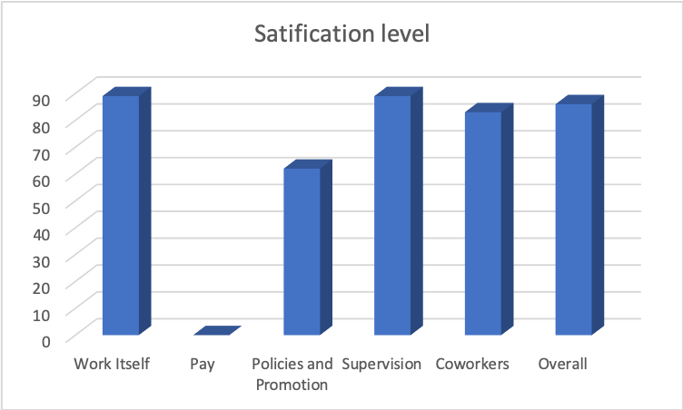
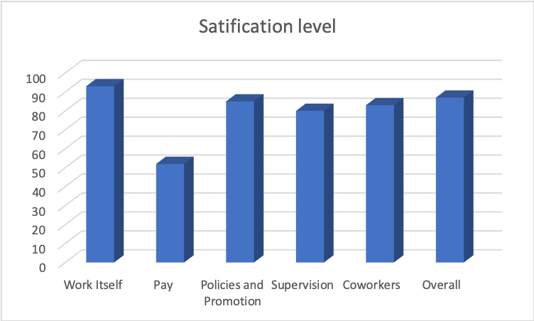
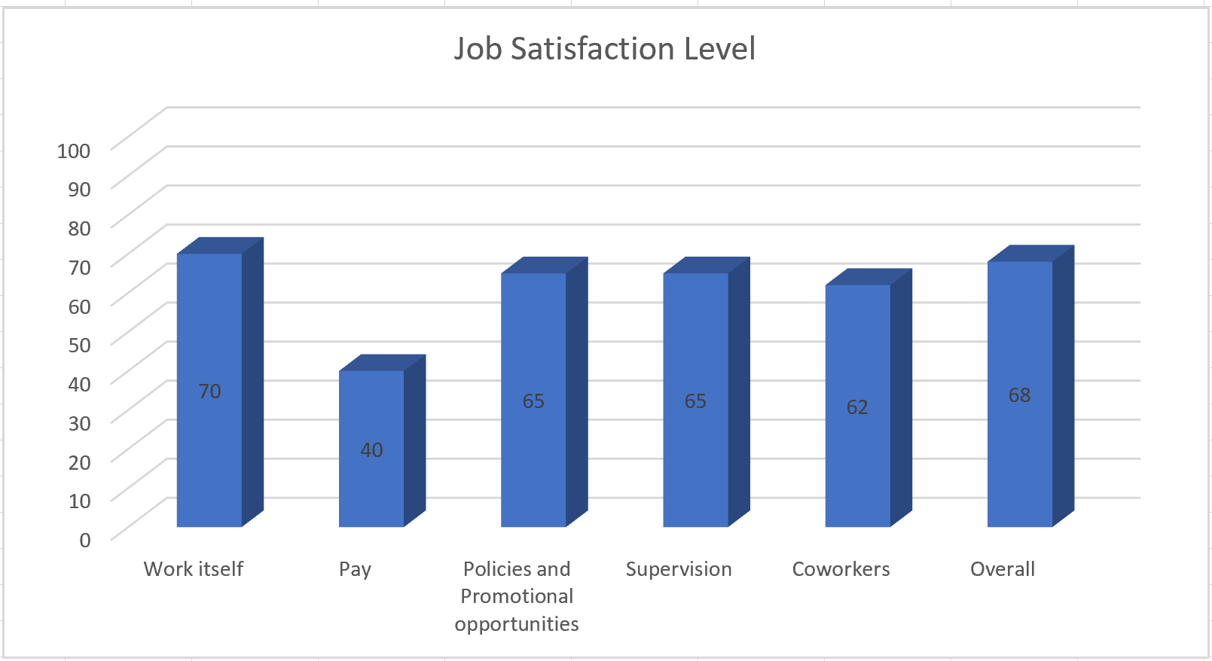
Agam Mehta
Prof. Aditya Tatu
Unrevealed

Slide 5
Analysis of the Interview: Kshitij Patel
Took interview of 3 alumnis : 1) Kartik Mudgal, 2) Nirbhay Ram and 3) Unrevealed. (Working in Sprinklr).
Similarities: All of them gave importance to work environment, policies and promotion opportunities, coworkers, supervision when job satisfaction was considered.
Dissimilarities: 1. Kartik gave more importance to pay scale than other two.
2. Also, he was found to have less commitment compared to other two.
Corner Case 1: High salary but too much workload, strict deadlines. So less satisfied with current working conditions. (Sprinklr)
Corner Case 2: Even though less satisfied and having less commitment, his performance was high (Reason: no tough work, easy projects and assignments) (Karitk)
General: More the job satisfaction and commitment, more is the performance.

Slide 6
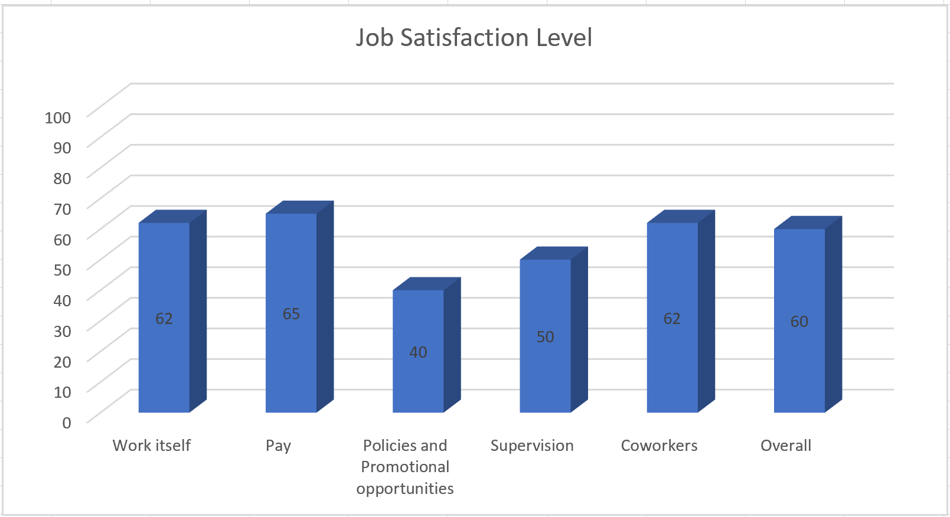
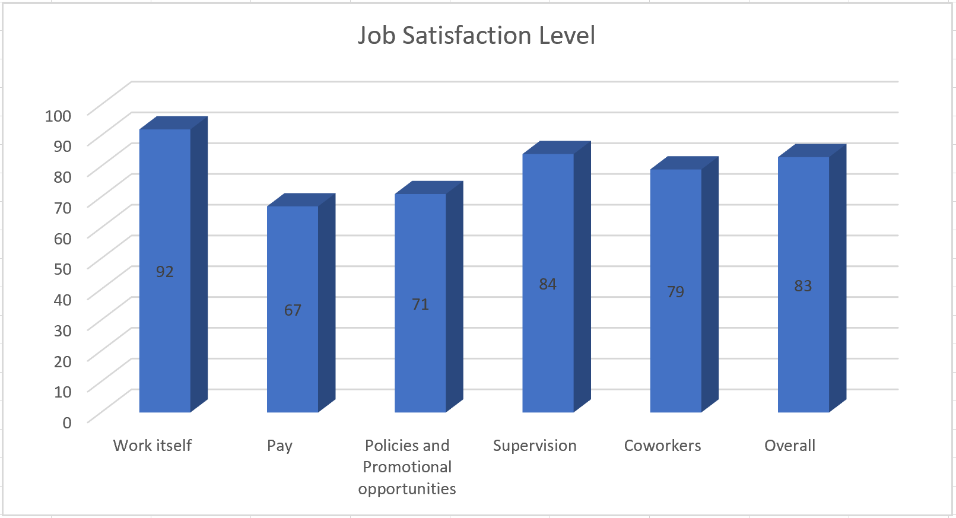
Kartik Mudgal
Nirbhay Ram
Unrevealed

Slide 7
Analysis of the Interview: Kunal Jani
Took interview of 3 alumnis : 1) Aravind Kumar, 2) Agam Shah and 3) Yash Patel
Similarities: Since there was constant supervision of employees in all the companies and the employees could directly approach the manager for any type of problem, they was more openness and thus the employees were satisfied to work in an open workplace which greater organizational commitment and thus greater job satisfaction thus greater job performance.
However, in a startup, there are less resources available to the employees due to the lower amount invested, there are lower promotional opportunities which is a cause of they are not appreciated since the rewards are less and so there is a lower job satisfaction and a lower job performance.

Slide 8
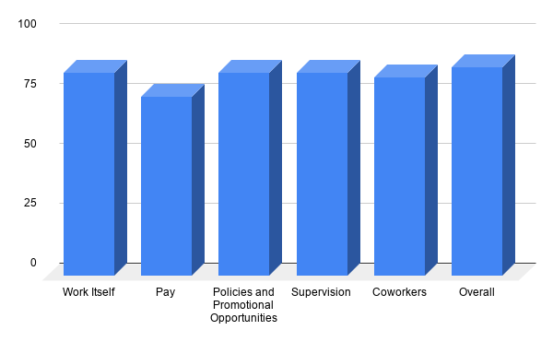
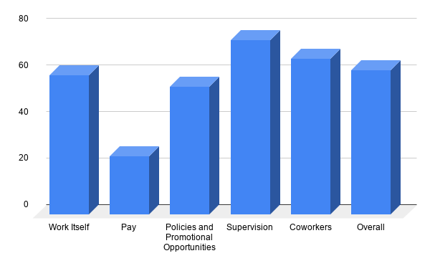
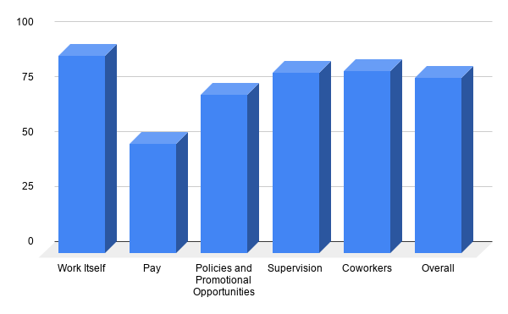
Yash Patel
Aravind Kumar
Agam Shah

Slide 9
Analysis of the Interview: Hardik Chhatrala
Took interview of 3 alumnis.
All three of them working in IT company in different area.
Similarities:
Stick to regularity and avoid procrastinare kind of behaviour.
Flexible working hour at their respective organization.
Organization which has open door policy for new learning and admire their views and ideas.
Pay scale is not much important as compare to new opportunities and organization culture.
Dissimilarities:
First one is good at fast learning from various sources and from person in different domains.
Second one believes in get job done with good perfection.
While the third one believe in learning a particular things in great details.
All the above similarities and dissimilarities reflect in their professional life and job commitment.

Slide 10
Person 1: Working with organization since beginning of his career and always try to give his best and committed to vision of his company.By using his strength every day he improve his work and job satisfaction.
Person 2: Recently change job and relocate to a new location. Reason for change job is to become part of large and reputed organization with good vision toward their services.
Person 3: Working with organization since beginning of his career but currently planning to change job. Reason for this is to kind of job and environment he want is not available at current organization. As he is self motivated and self learner he does not like promotion policies over there.
Opportunity leads to growth and challenging work leads to high job satisfaction and good commitment towards organization.

Slide 11
Analysis of the Interview : Vishva Patel.
Took interview of 3 alumnis : 1) Anupriya Jaju, 2) Ekta Bhoraniya and 3) Hardi Sudhagar.
Similarities : All of them were quite positive of their profile they are working in.
They all gave importance to work environment , policies and promotions opportunities .
They all have healthy supervision and approachable supervisor.
Dissimilarities : Anupriya was found to have somewhat less commitment than other two.
Even though less commitment her performance was high .
Overall they have high job satisfaction and commitment , so they also have high performance

Slide 12
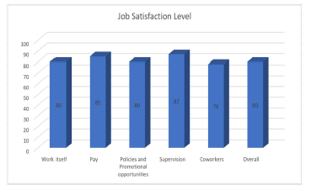
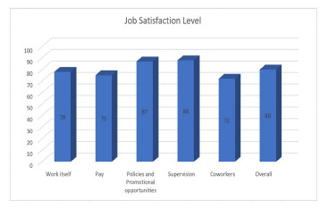
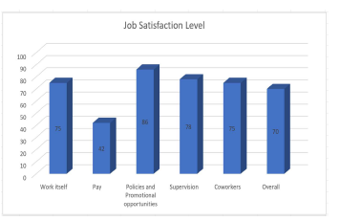
Anupriya Jaju.
Ekta Bhoraniya.
Hardi Sudhagar.

Slide 13
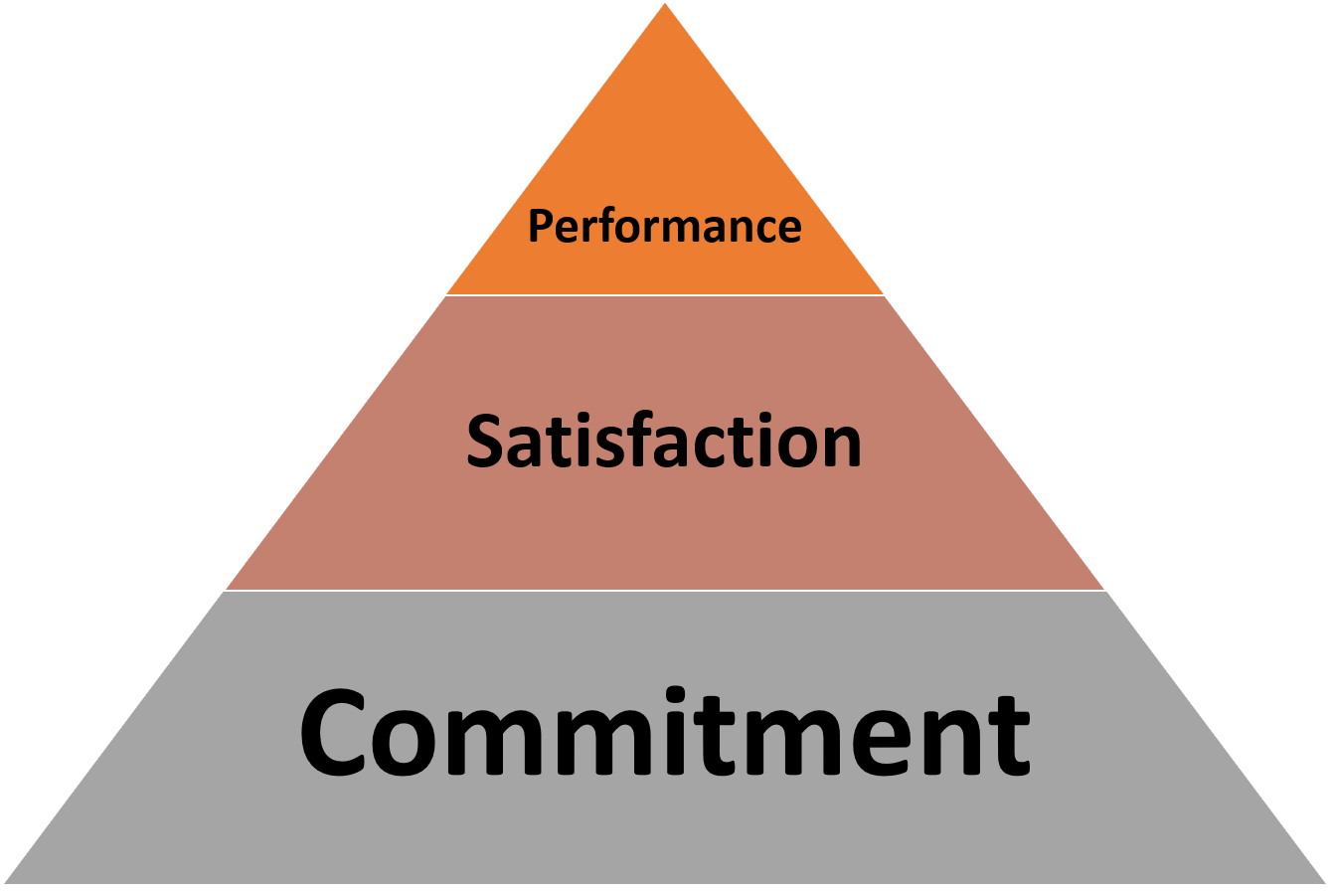
Conclusion
In most of the cases, the factors which positively affect job commitment also affected job satisfaction.
Job performance mainly depend on the flexibility of working hours and the continual supervision.
Also, job commitment has direct influence on job satisfaction, and thus both affects the performance.
In short, nature of work and greater organizational commitment increases job satisfaction, which in return enhances performance of the individual.
Notes:
(Highly committed individuals are ready to work even after the working hours!)

